Slide 1

Julia’s Jewels
Person 1
Email:
Person 2
Email:
Person 3
Email:
Notes:
Julia

Slide 2
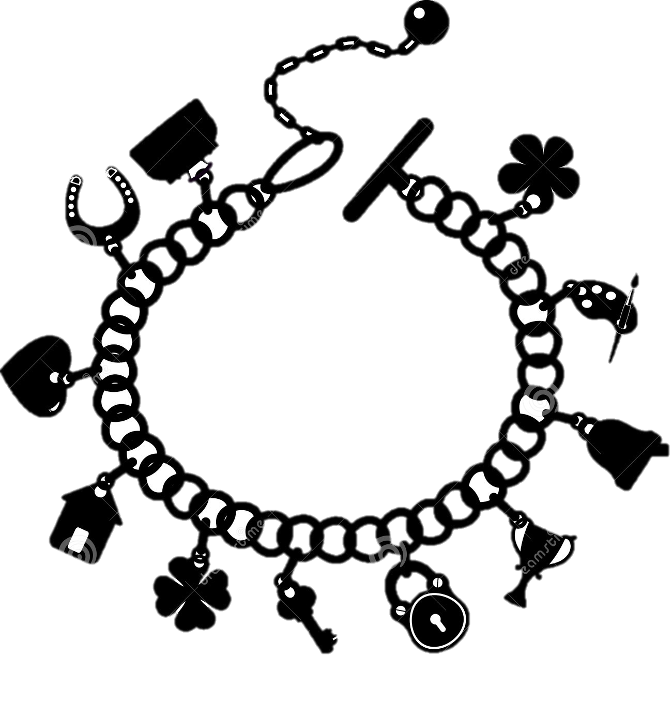

What if?
Imagine your favorite bracelet suddenly broke
Currently have two options:
1. Put in drawer, forget about it, eventually throw it away: ☹
2. Try to locate closest jewelry store, drive there and back to have it repaired, no guarantee you will even find a store: ☹
That’s where we come in: ☺
Notes:
Julia

Slide 3
Who Are we?
Julia’s Jewels is a mail-in repair service for your beloved jewelry pieces
We are revolutionizing the jewelry repair service industry by introducing a cheaper, faster and more convenient service
Aim to target the largely untapped market of broken fashion and medium priced jewelry
Notes:
Julia

Slide 4
What problem do we solve?
Pieces of low-to-medium priced jewelry break easily
Usually forgotten and eventually thrown away
We offer a fast, easy and convenient way to repair these pieces
Don’t waste precious time locating and driving to a jewelry store
Simply send us your broken pieces
Notes:
Julia

Slide 5
What is our market?
Current Jewelry Repair Industry:
$500 Million annual revenue
Highly fragmented, low level of concentration = low barriers to entry
Leading firm only 1% market share
Reasonable goal of 0.5-1% market share or $2.5-5 Million in revenue
Untapped Fashion Jewelry Owner Market:
Hard to estimate size of target market in this industry, but higher chance of pieces breaking
Have broken pieces, don’t usually seek to repair due to limited time and money
Fashion Jewelry Sales industry $200 Billion annual revenue
Notes:
Julia, Assume based on market outreach and interviews, ~1 in 4 pieces break

Slide 6

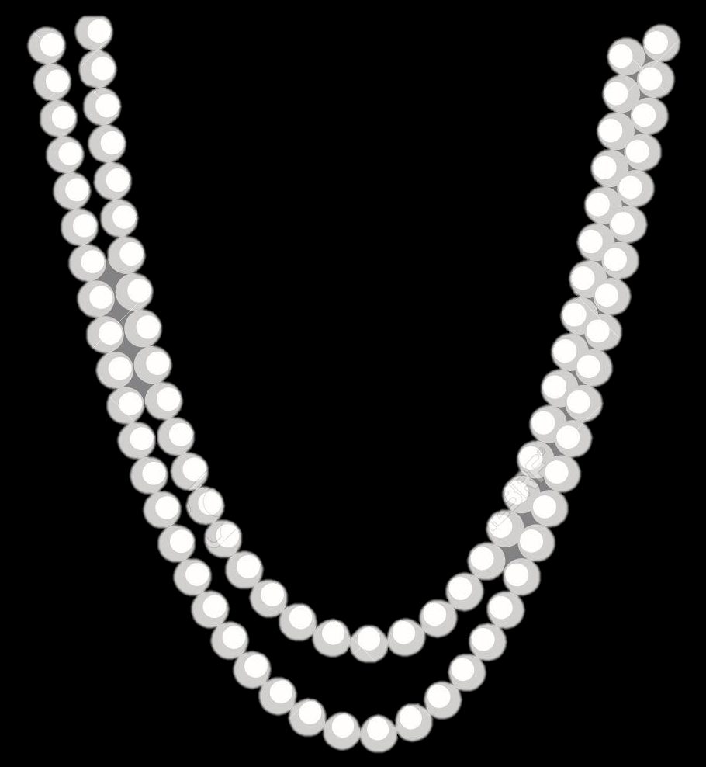
Who Will We Be Targeting?
Fashion Jewelry Owner:
Young- middle-aged
Busy individual
Wears fashion jewelry as a means of self-expression
Jewelry has high sentimental value
Notes:
Justin
customer segments were formed based upon insights from consumer interviews[MP1] , industry reports, and market projections.

Slide 7



How do we do it?
Julia’s Jewels
Customer sends photo of broken piece via app, website or email
Accept quote + mail broken piece in padded envelope via USPS priority mail
We fix it piece in our warehouse in Idaho
Receive cost and time quote within 24 hours
Promptly return
Notes:
Justin

Slide 8



Who are our competitors?
Jewelry retailers such as Kay Jewelers, Zales, Tiffany & Co.
We provide a faster service at rapid return rate
Specialized jewelry repair stores (brick and mortar) such as Fast-Fix
We are more convenient with mail-in service that is not location dependent
Mail-in jewelry repair services (online) such as Vanguard Jewelry
We are a more affordable service with a lower average repair fee
Notes:
Justin

Slide 9
How will we market?
Year 1: Focus on online and WOM marketing
Year 2: Focus on in-store, magazine and trade show marketing
Notes:
Justin

Slide 10
who will we partner with?
USPS
Department Stores
Create business account for all mail services
Hire experienced jeweler to train our workers
Possibly take on excess capacity repairs
Contract to become sole provider of jewelry department repair services
Julia’s Jewels will establish reputation/awareness
Department stores can boost customer’s WTP, and achieve more efficient business by streamlining efforts strictly towards sales
Independent Jewelers
Includes priority shipping, supply of padded envelopes and premium insurance
Notes:
Justin

Slide 11
Risks?
Risk
Mail could get lost
Difficulty in establishing partnerships
Mitigation
Business partnership with USPS includes insured and tracked priority service
Hire experienced sales people
Demand Uncertainty
Introduce membership option with incentives for referrals and bulk discounts
Notes:
Justin

Slide 12
How will we make money?
Price/ unit
$32
Cost/unit
$10
Contribution/unit
$22
Notes:
Alex

Slide 13
How much money will we make?
High fixed cost and low sales at first lead to negative income
Hire first sales representative in June to increase growth of sales
With sales rep, the cumulative income losses are 60% lower in second half of year
Notes:
Alex

Slide 14
When do we break even?
Hire 2nd sales representative start of year 2 to continue sales growth
Breakeven in Feb
Reach Max. Capactiy of 1,000 units in August
Positive Cumulative Income in October
Notes:
Alex

Slide 15
How will we grow?
Reach max capacity of plant at end of year 2
Expand capacity of plant by $30,000 which slightly lowers net income in year 3
Reach max Capacity of larger plant in year 5
Seeking possible buyers in year 5
Notes:
Alex

Slide 16
How can you invest?
Seeking to raise A Round:
$120,000 in exchange for 40% equity
Breakdown of Investment:
$55,000: Facility investment, salary, advertisement and raw material before positive net income in Year 2
$15,000: Technology and engineering of app/website
$40,000: Insurance policy
$10,000: Purchase of repair tools and warehouse equipment
Notes:
Alex

Slide 17
why should you invest?
Innovative Service: Faster and more convenient alternative to current repairs
First Mover: Enter currently untapped market of fashion jewelry repair services
Growth Opportunity: Fashion Jewelry market already very profitable and projected to grow
Notes:
Julia

Slide 18
Thank you. Any questions?

Slide 19
Backup Slides
Notes:
Julia

Slide 20
First year Income Statement
Yr1($) | Jan | Feb | Mar | Apr | May | Jun | Jul | Aug | Sep | Oct | Nov | Dec
Sales | 1,926 | 2,247 | 2,568 | 2,889 | 3,210 | 4,494 | 5,778 | 7,062 | 8,346 | 9,630 | 10,914 | 12,198
CoGs | 7,906 | 7,973 | 8,041 | 8,109 | 8,176 | 8,672 | 9,006 | 9,341 | 9,676 | 10,010 | 10,345 | 10,680
GP | (5,980) | (5,726) | (5,473) | (5,220) | (4,966) | (4,178) | (3,228) | (2,279) | (1,330) | (380) | 569 | 1,518
MK | 500 | 500 | 500 | 500 | 500 | 500 | 1,700 | 1,700 | 1,700 | 1,700 | 1,700 | 1,700
G&A | 100 | 100 | 100 | 100 | 100 | 100 | 200 | 200 | 200 | 200 | 200 | 200
EBIT | (6,580) | (6,326) | (6,073) | (5,820) | (5,566) | (4,778) | (5,128) | (4,179) | (3,230) | (2,280) | (1,331) | (382)
CI | (6,580) | (12,906) | (18,979) | (24,799) | (30,365) | (35,143) | (40,271) | (44,450) | (47,680) | (49,960) | (51,291) | (51,673)

Slide 21
Second year Income Statement
Yr2($) | Jan | Feb | Mar | Apr | May | Jun | Jul | Aug | Sep | Oct | Nov | Dec
Sales | 14,720 | 17,013 | 19,260 | 21,507 | 23,754 | 26,001 | 28,248 | 30,495 | 32,100 | 32,100 | 32,100 | 32,100
CoGs | 12,088 | 12,786 | 13,484 | 14,182 | 14,880 | 15,578 | 16,276 | 16,974 | 17,473 | 17,473 | 17,473 | 19,385
GP | 2,632 | 4,227 | 5,776 | 7,325 | 8,874 | 10,423 | 11,972 | 13,521 | 14,627 | 14,627 | 14,627 | 12,715
MK | 3,000 | 3,000 | 3,000 | 3,000 | 3,000 | 3,000 | 3,000 | 3,000 | 3,000 | 3,000 | 3,000 | 3,000
G&A | 400 | 400 | 400 | 400 | 400 | 400 | 400 | 400 | 400 | 400 | 400 | 400
EBIT | (768) | 827 | 2,376 | 3,925 | 5,474 | 7,023 | 8,572 | 10,121 | 11,227 | 11,227 | 11,227 | 11,227
CI | (52,440) | (51,613) | (49,413) | (45,778) | (40,709) | (34,206) | (26,268) | (16,896) | (6,500) | 3,896 | 14,292 | 24,689

Slide 22
Key Financial AssumptionS
 | Year 1 | Year 2 | Year 3 | Year 4 | Year 5
Units Sold | 2,220 | 9,640 | 11,086 | 12,749 | 14,661
Fixed Overhead | $90,000 | $90,000 | $120,000 | $120,000 | $120,000
Yr1 | Jan | Feb | Mar | Apr | May | Jun | Jul | Aug | Sep | Oct | Nov | Dec
US | 60 | 70 | 80 | 90 | 100 | 140 | 180 | 220 | 260 | 300 | 340 | 380
Yr2 | Jan | Feb | Mar | Apr | May | Jun | Jul | Aug | Sep | Oct | Nov | Dec
US | 460 | 530 | 600 | 670 | 740 | 810 | 880 | 950 | 1,000 | 1,000 | 1,000 | 1,000
Average Selling Price: $32.00
Material Cost per Unit: $3.05
Direct Labor Cost per Unit: $0.71
Variable Overhead per Unit: $3.00
Commission per unit per sales rep: 5%

Slide 23
Average cost calucations
Type of Repair | Price Avg | Material Cost | Time Per Order (hrs) | Labor Cost per Hour (based in Idaho) | % of Total Sales Orders | Ave. Revenue per Order | Ave. Labor Cost per Order | Ave. Material Cost per Order | Ave personal commision per order
Ring Repair | $50.00 | $2.00 | 0.17 | $7.25 | 10.00% | $5.00 | $0.12 | $0.20 | $0.25
Chain Repair | $26.00 | $1.00 | 0.08 | $7.25 | 10.00% | $2.60 | $0.06 | $0.10 | $0.13
Clasp Repair | $15.00 | $0.40 | 0.03 | $7.25 | 25.00% | $3.75 | $0.06 | $0.10 | $0.19
Prong Repair | $20.00 | $1.00 | 0.13 | $7.25 | 10.00% | $2.00 | $0.10 | $0.10 | $0.10
Stone Replacement | $55.00 | $10.00 | 0.13 | $7.25 | 25.00% | $13.75 | $0.24 | $2.50 | $0.69
Restringing | $15.00 | $0.50 | 0.08 | $7.25 | 10.00% | $1.50 | $0.06 | $0.05 | $0.08
Stone Setting/Tightening | $35.00 | $0.00 | 0.10 | $7.25 | 10.00% | $3.50 | $0.07 | $0.00 | $0.18
Total |  |  |  |  |  | $32.10 | $0.71 | $3.05 | $1.61

Slide 24
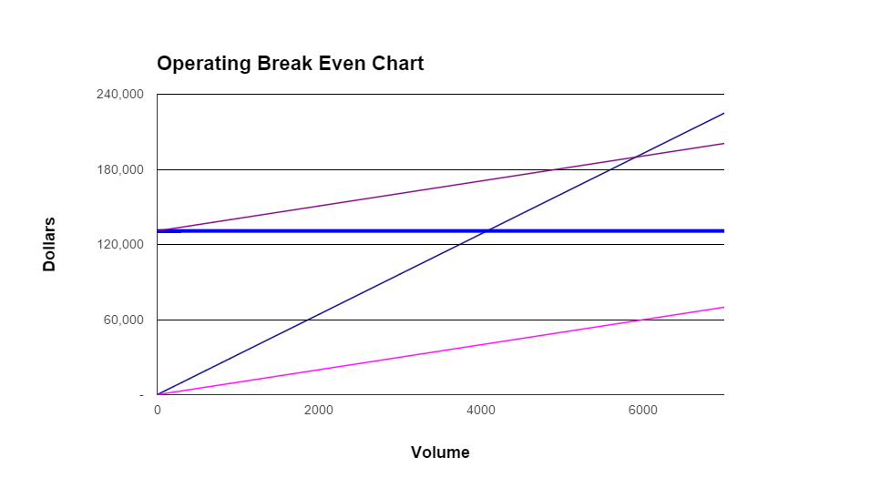
breakeven chart
Contribution per unit
Revenue per unit | $32
Variable cost | $10
Contribution per unit | $22
Fixed costs | $130,800
Break-even volume per year | 5911(493 per month)

Slide 25
Management
Management team of three co-founders
Will each have unique roles: Person 1 for operational overview, Person 2for marketing strategies and Person 3 for finance handling and investor relations
Able to work together effectively and efficiently, all have different skill sets, proven in many experiences working on team both at college and in work place
Will need to hire workers to conduct repairs as well as sales representatives to form partnerships with large fashion jewelry retailers

